Slide 1

Data Science Industry Analysis
By: Chloe Adams & Carson Schau

Slide 2
The Problem:
What does the data Science field look like in terms of job opportunities, working arrangements, and salary?
What aspects affect salary in this field?

Slide 3
The Data:
2023 data science industry and salaries Kaggle dataset
607 rows across 12 fields
Salary, working arrangement, company size, job titles, experience, etc.

Slide 4
The Plan:
The plan for this project is to import data about the data science industry and perform analyses using Python to answer our questions. We will look at the following things:
Job positions
Working arrangements
Salary
During this analysis, we used applications learned in class including functions and libraries to analyze the data and uncover insights that may be useful to people exploring a career in data science.
This project tested our knowledge of many different skills including computing, utilizing functions, and plotting which was essential in arriving at an appropriate solution.

Slide 5
Libraries, Modules, & Functions employed
Libraries
Pandas
Matplotlib
Modules
Utilities.py
Main.py
Functions
processData()
getTopJobTitles()
getRemoteWork()
getSalary()
getSalaryByExperience()
getSalaryByCompanySize()

Slide 6
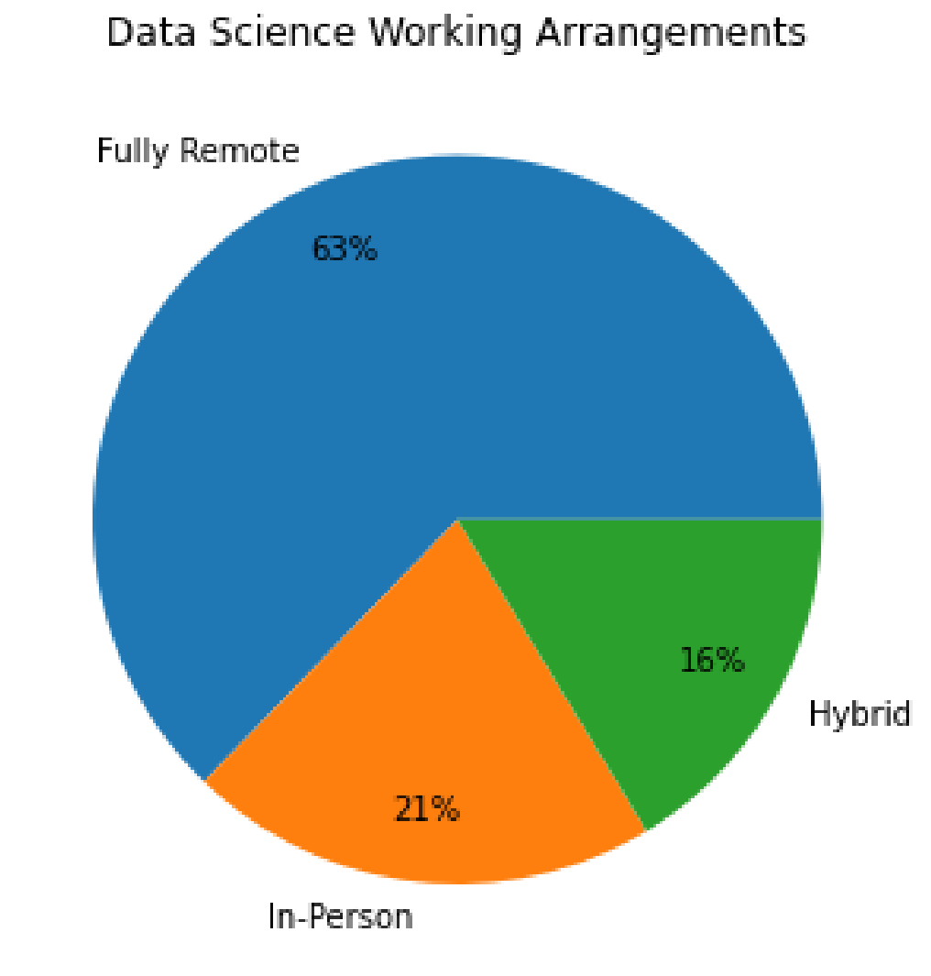
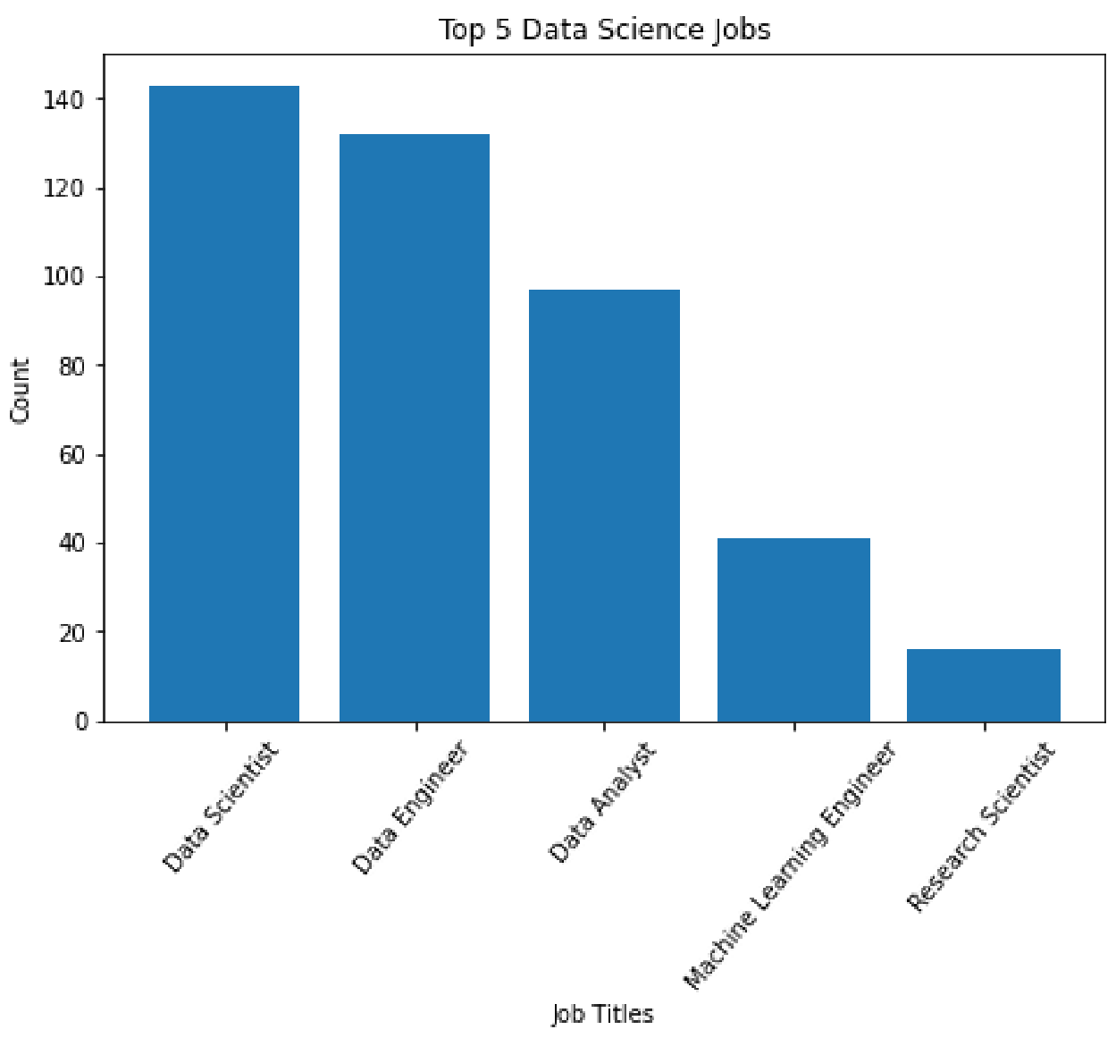
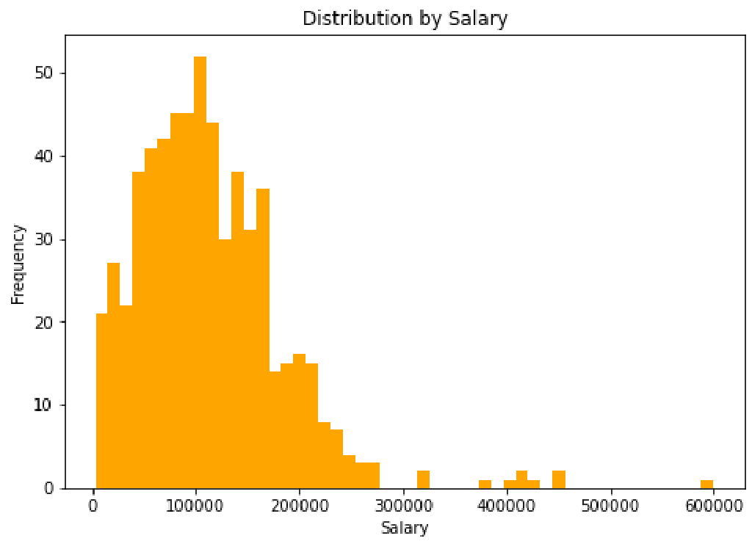
The Output
Notes:
Do a demo!

Slide 7
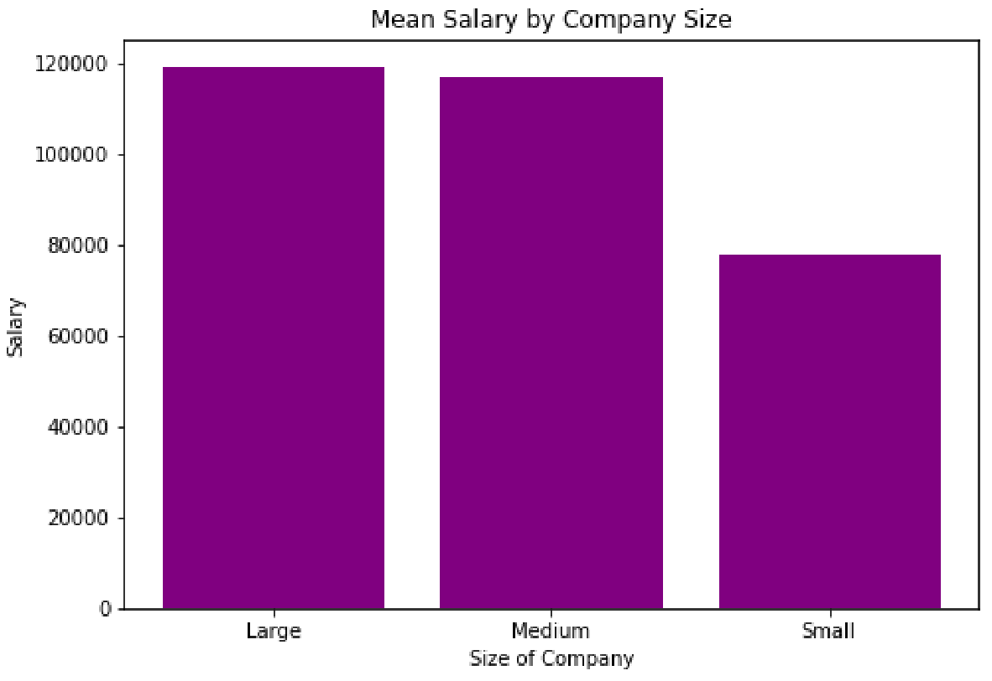
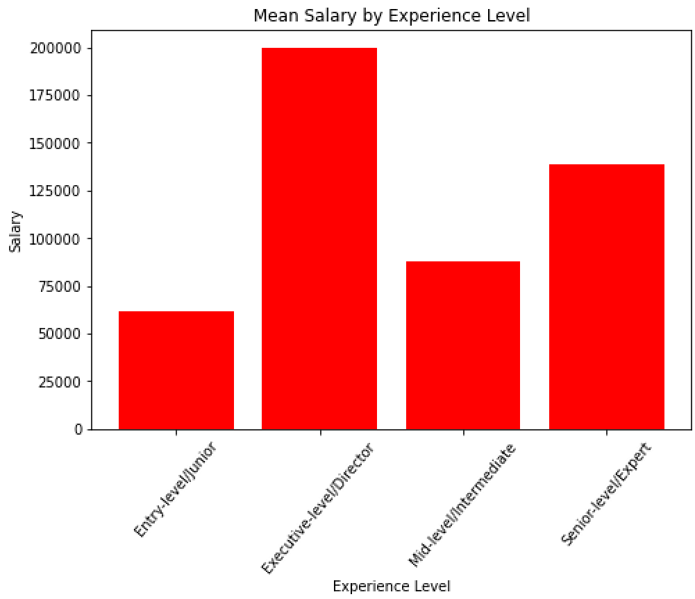
The Output Continued
Notes:
If running short on time we could get rid of the mean per year graph!

Slide 8
The Takeaway:
The data science industry offers many opportunities to be successful
Many job positions
Several opportunities for remote and hybrid work
High salaries
Salary varies by:
Experience level
Company size

